Slide 1

After School Program Management System
Product Overview Presentation
CSC 4350 / CSC 6350
Team 7

Slide 2
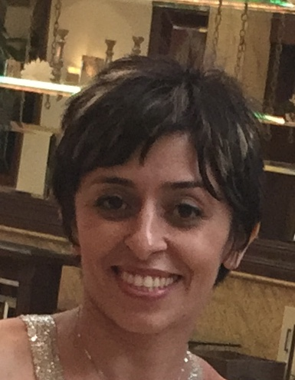
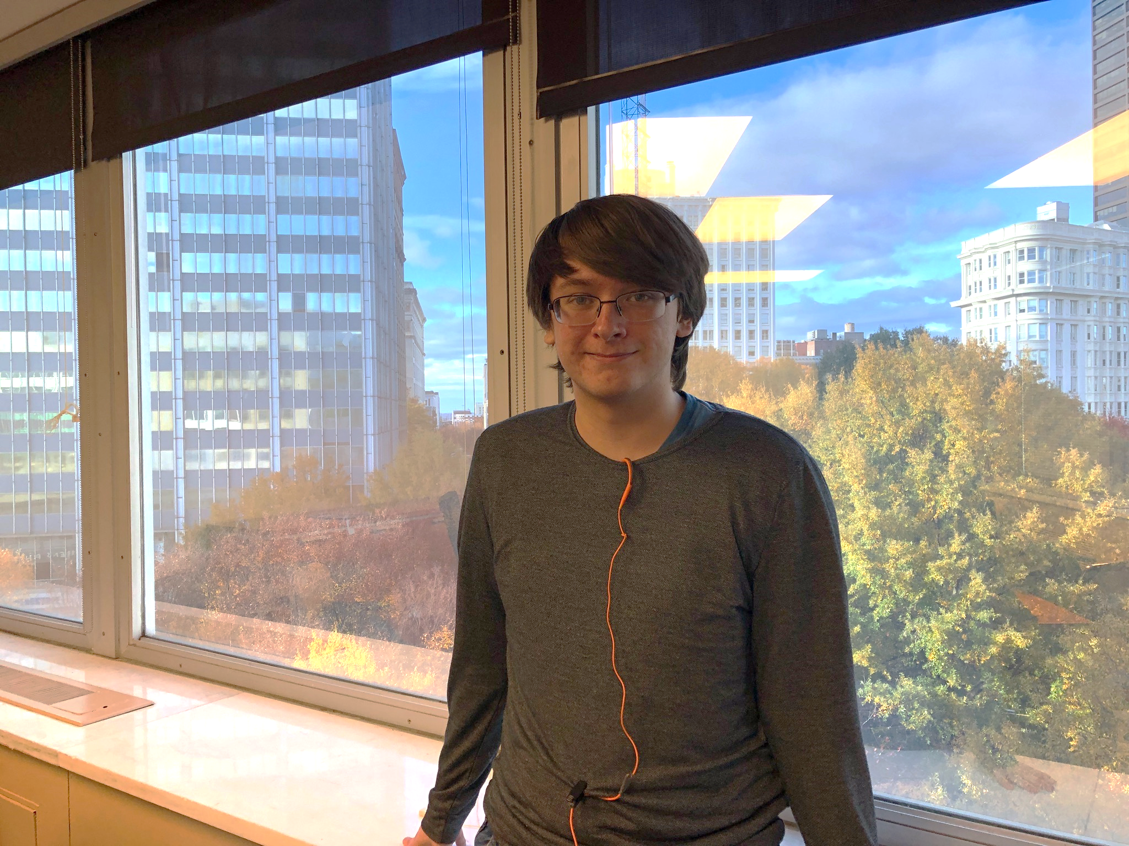


Team Members
Developer
Developer
Product Owner
Scrum Master

Slide 3
Product Overview
Web Application to assist management of an After School Program
Track student information
Track list people authorized to pick up students
Track classes offered
Track instructors assigned to a class

Slide 4
Technology Stack
PHP – backend development
1
Apache Web Server
2
JQuery and JavaScript – interactivity on webpages /
3
Bootstrap – CSS style sheets
4
MySQL database
5
Datatables
6

Slide 5
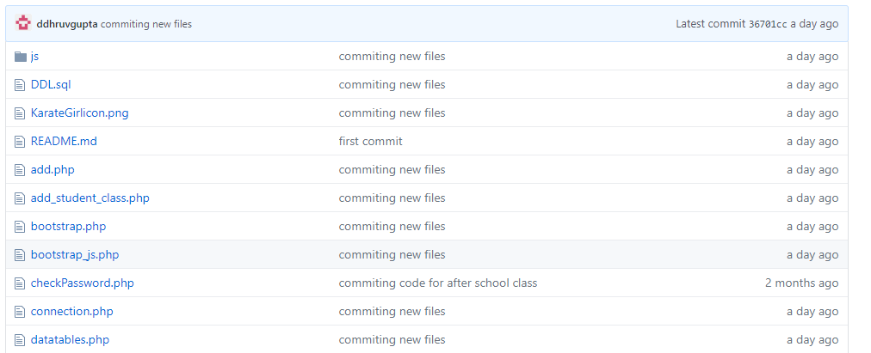
Code Repository – Version Control

Slide 6
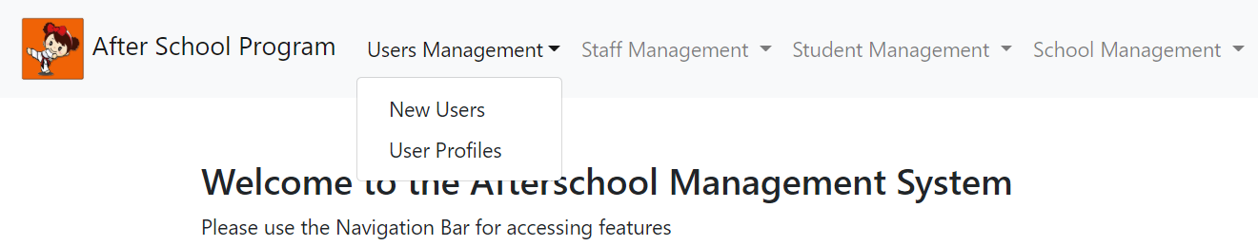
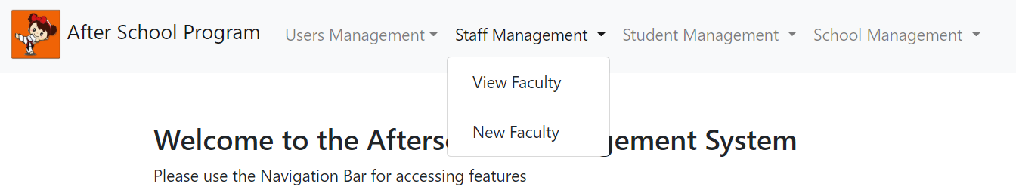
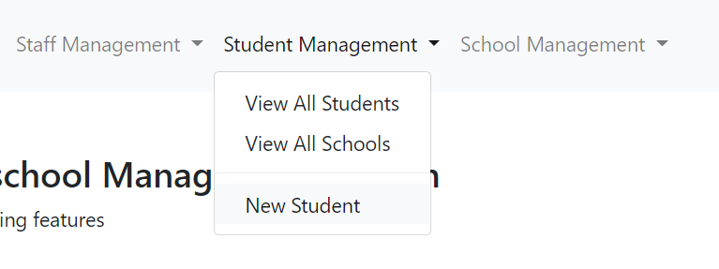
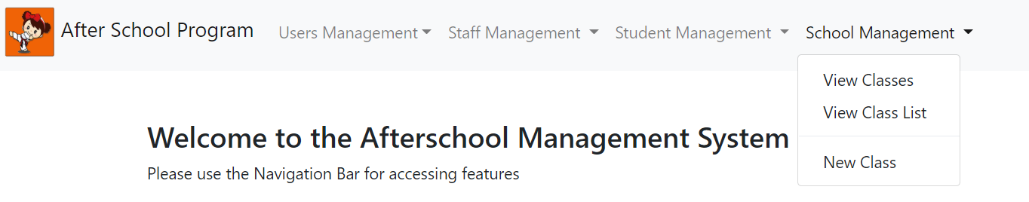
Product Services

Slide 7
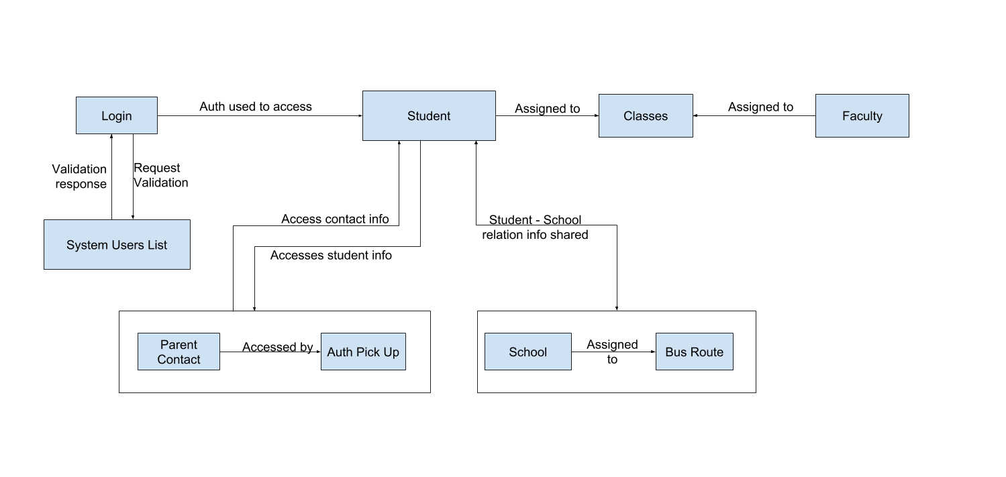
Architecture Diagram

Slide 8
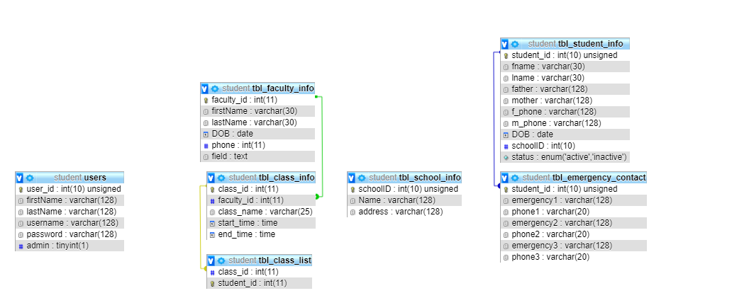
Database Schema

Slide 9
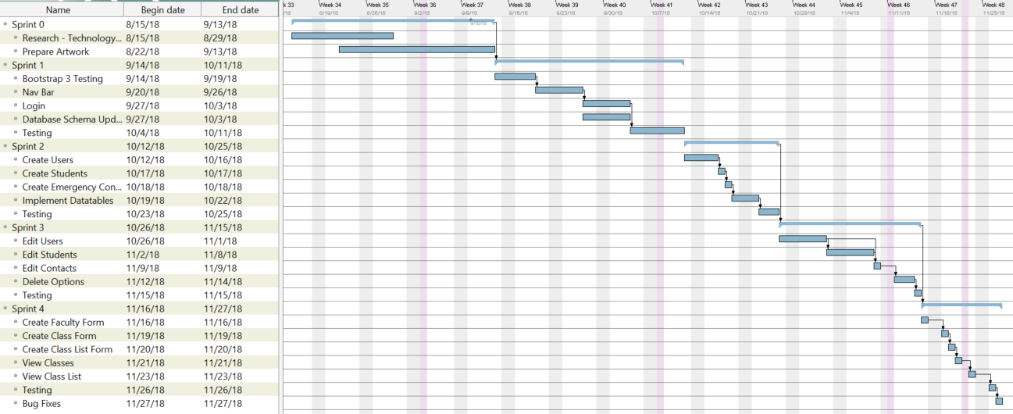
GANTT Chart

Slide 10
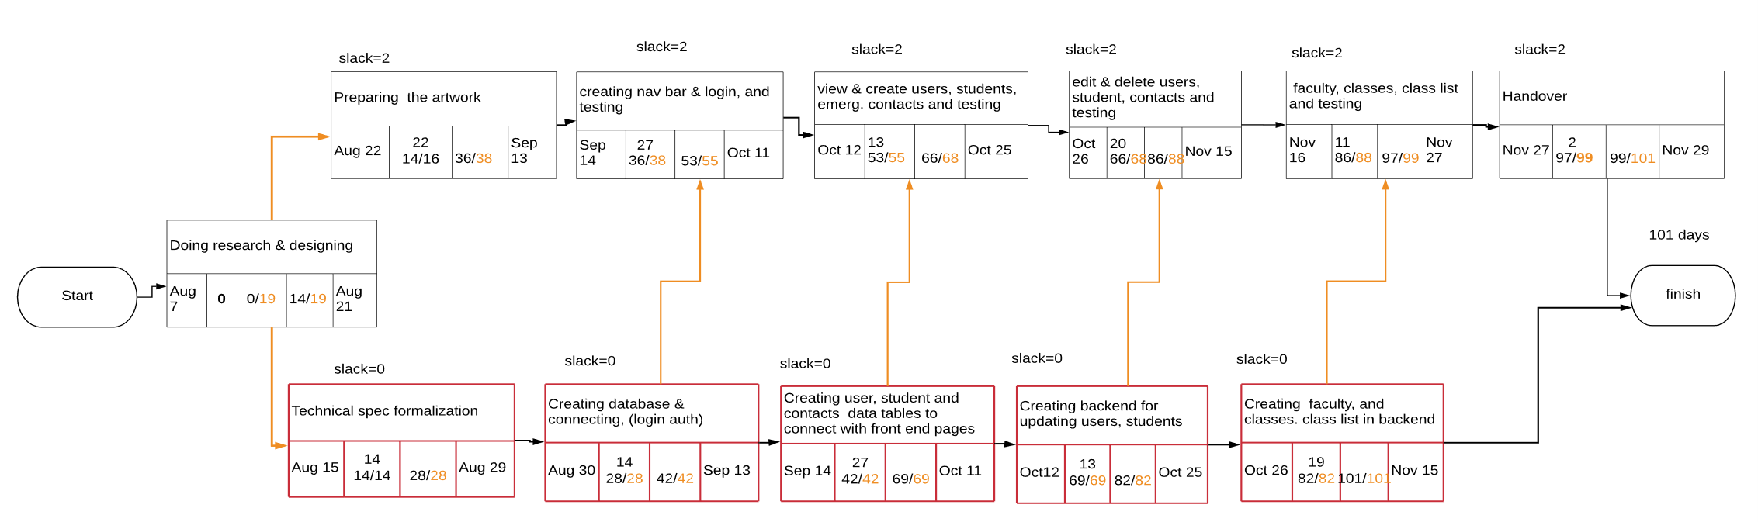
PERT Chart

Slide 11
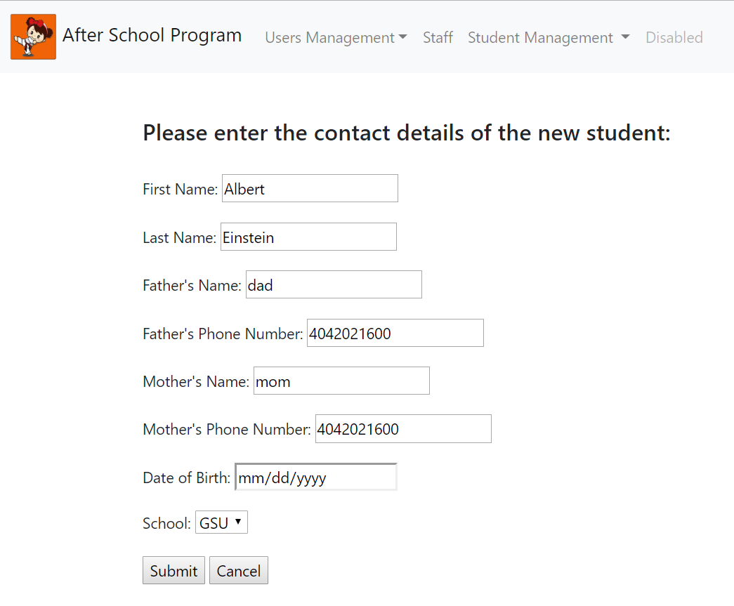
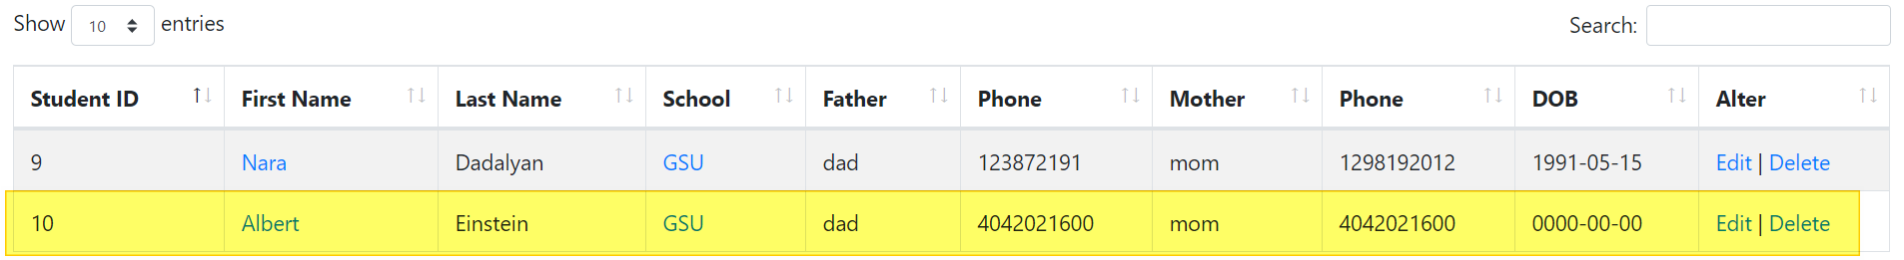
Creating a new Student

Slide 12
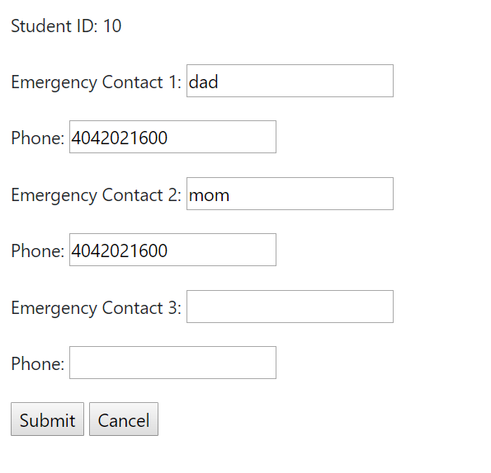
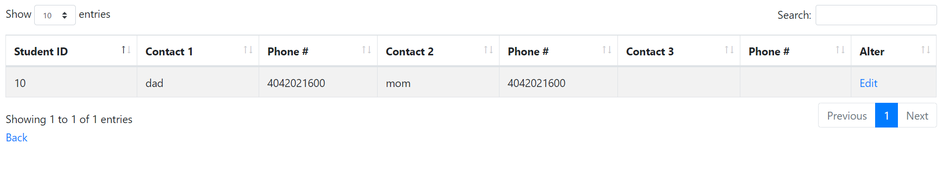
View and Edit Contact Information

Slide 13
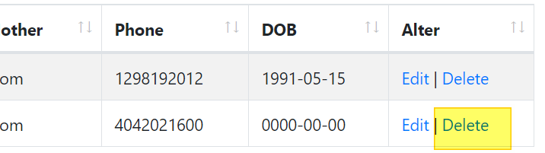
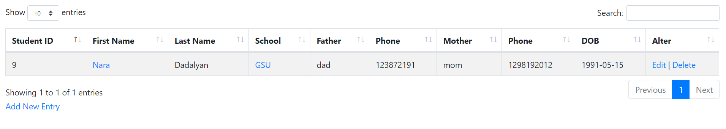
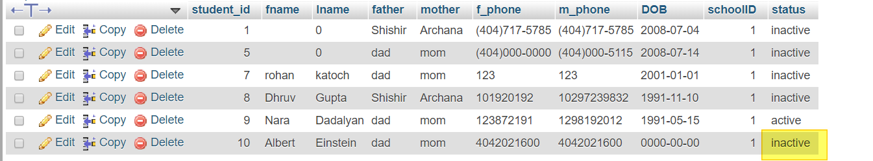
Delete Student – Archives the record

Slide 14
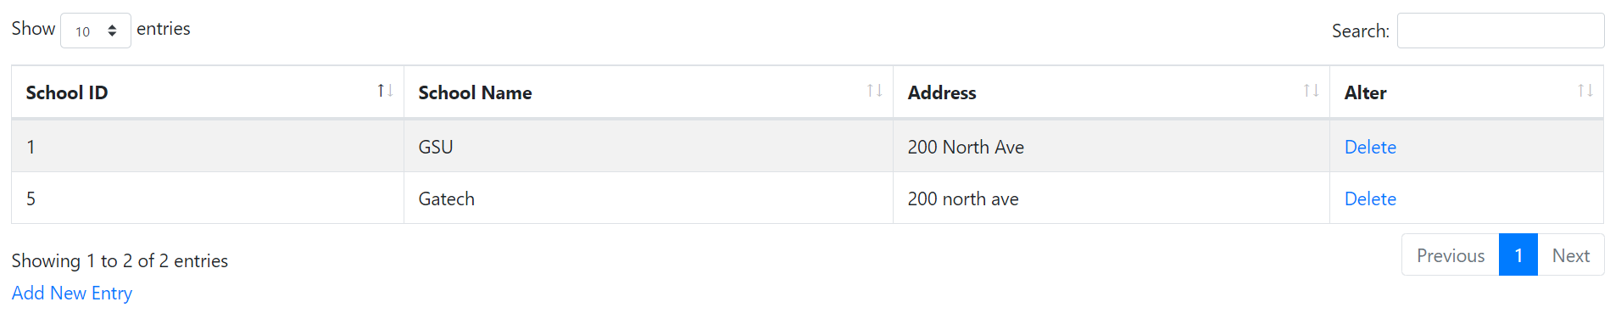
View School Info

Slide 15
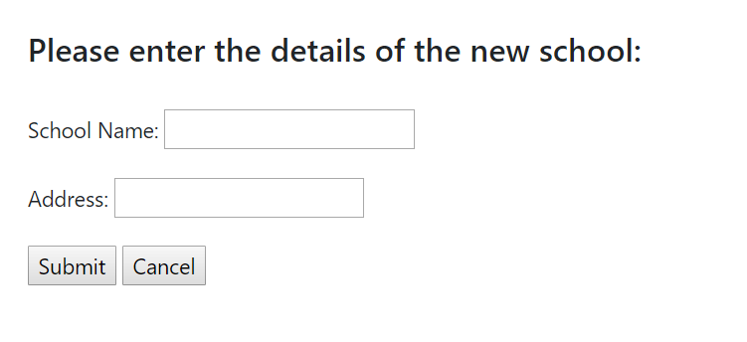
Create New School Record

Slide 16
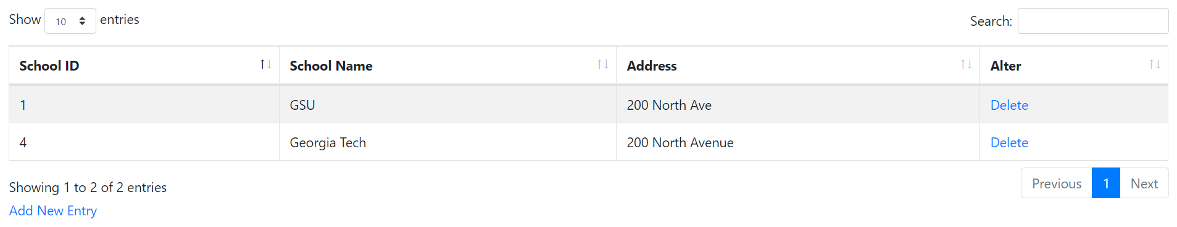
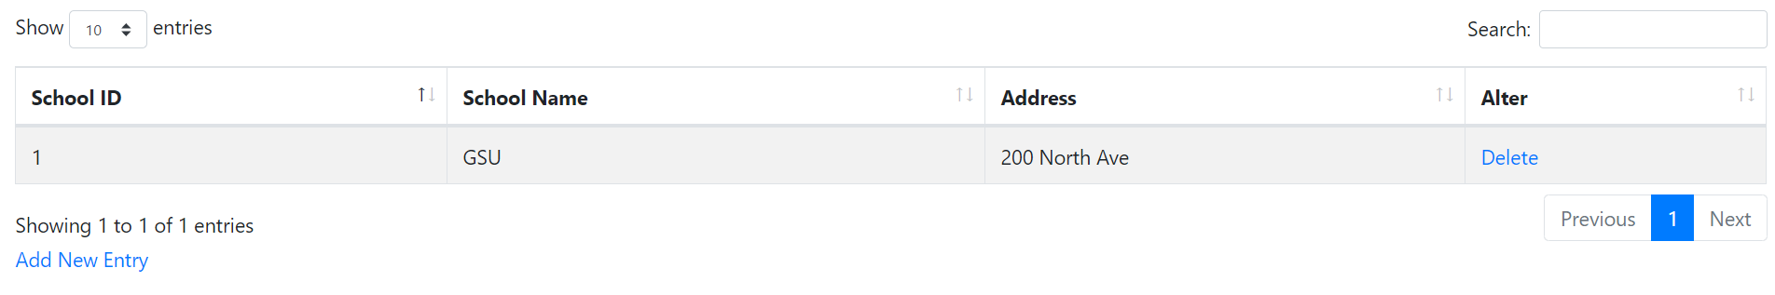
Delete School

Slide 17
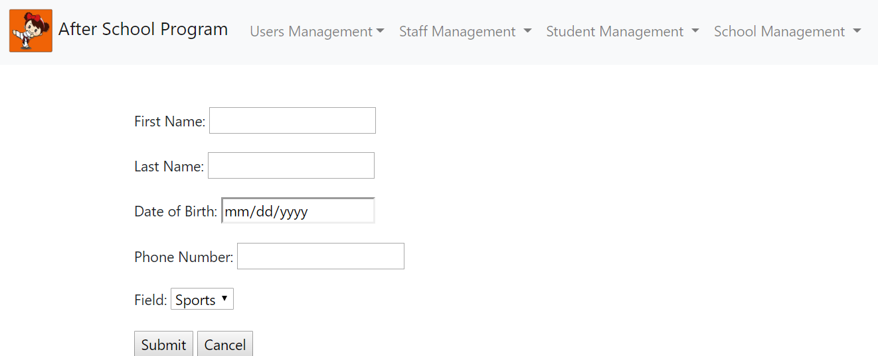
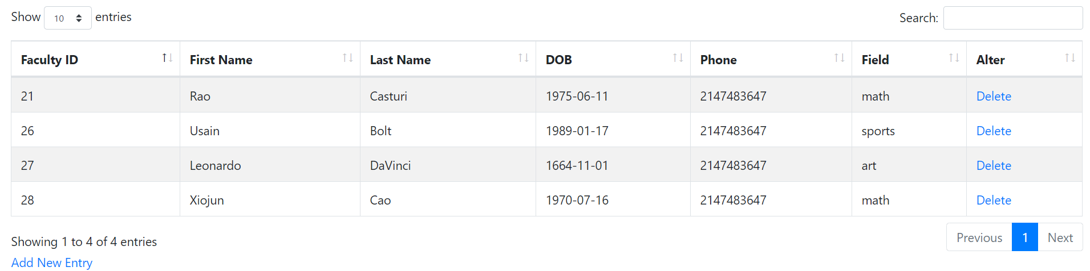
Faculty Management

Slide 18
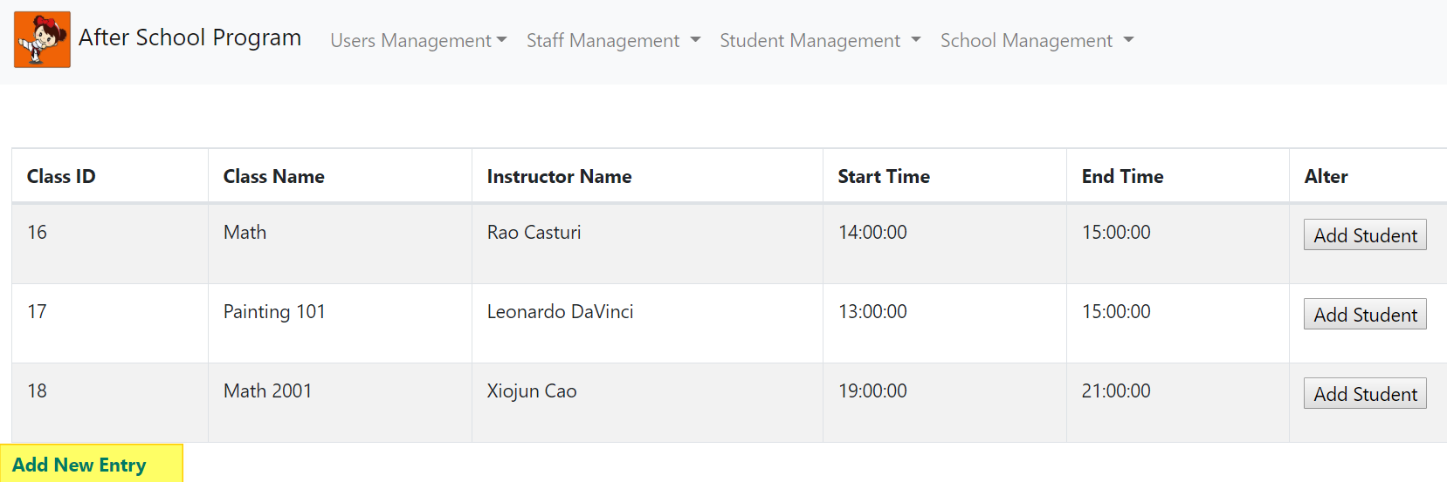
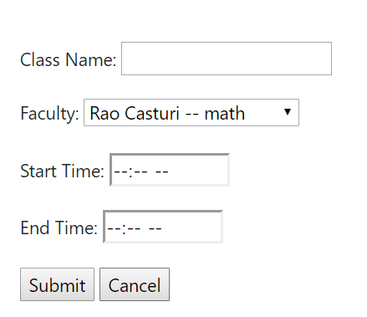
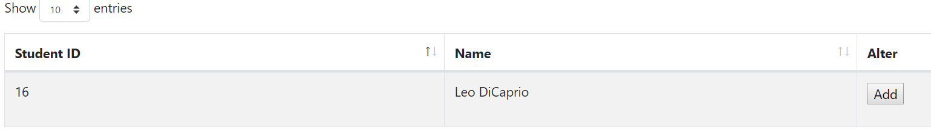
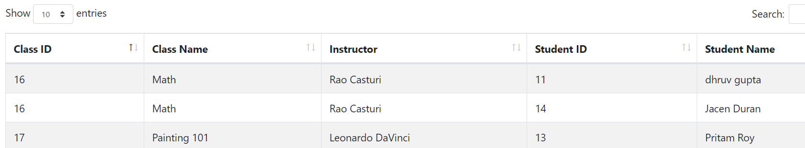
Class Management

Slide 19
Demo Time

Slide 20
Project Challenges
Angular – PHP compatibility issues
Bootstrap – Angular compatibility issues
Bootstrap 3 – JQuery compatibility issues
Update to Bootstrap 4
Initial database schema and changes during development
Implementing search feature

